Slide 1

telco company
that provide home phone and Internet services

Slide 2
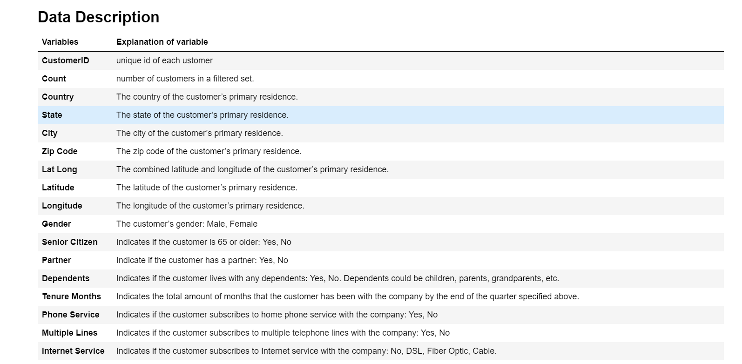

Slide 3
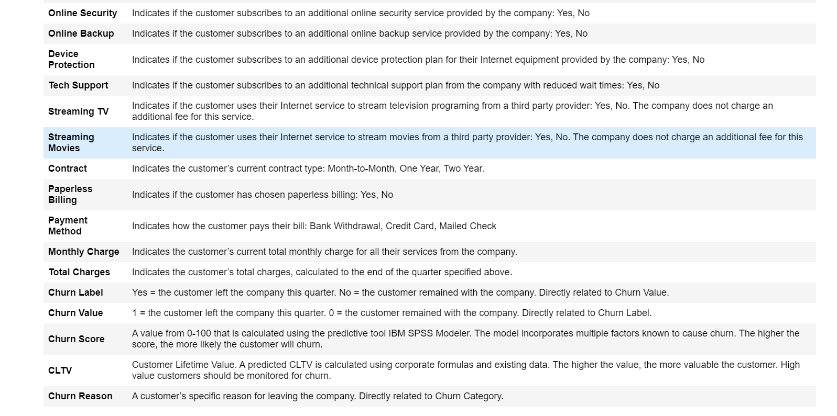

Slide 4
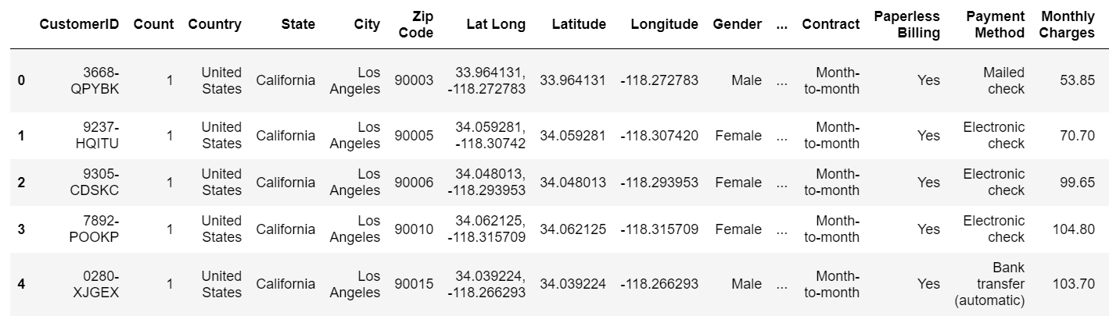
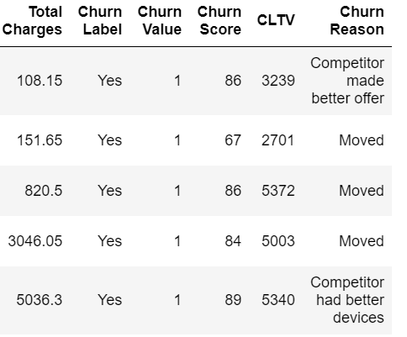
Head of the Table

Slide 5
read the file and explain data types statistically as well as how python is reading it. Please let us know if any data type is read wrong.

Slide 6
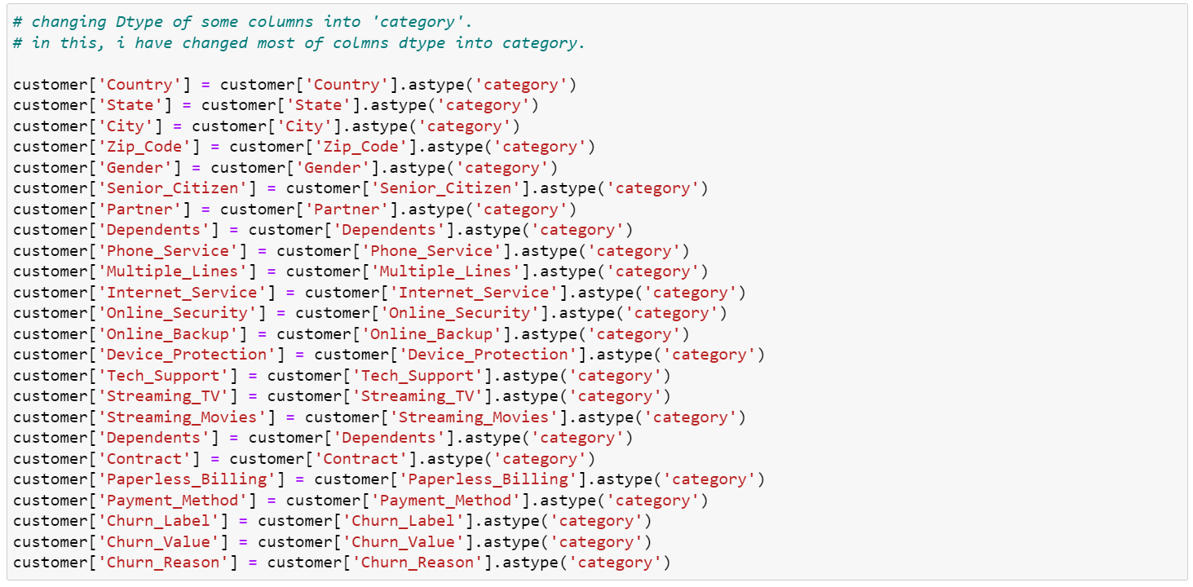
Changing the Dtype of Columns

Slide 7
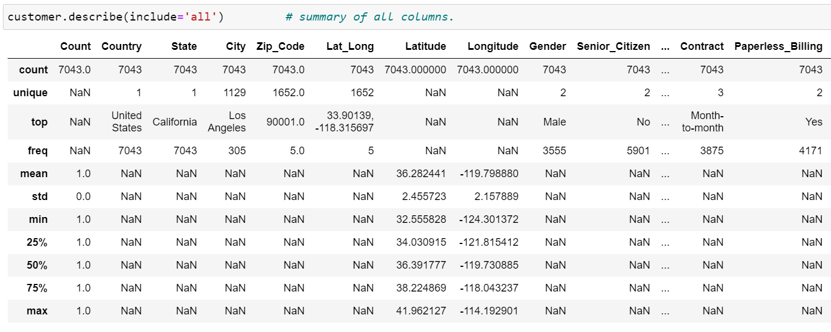
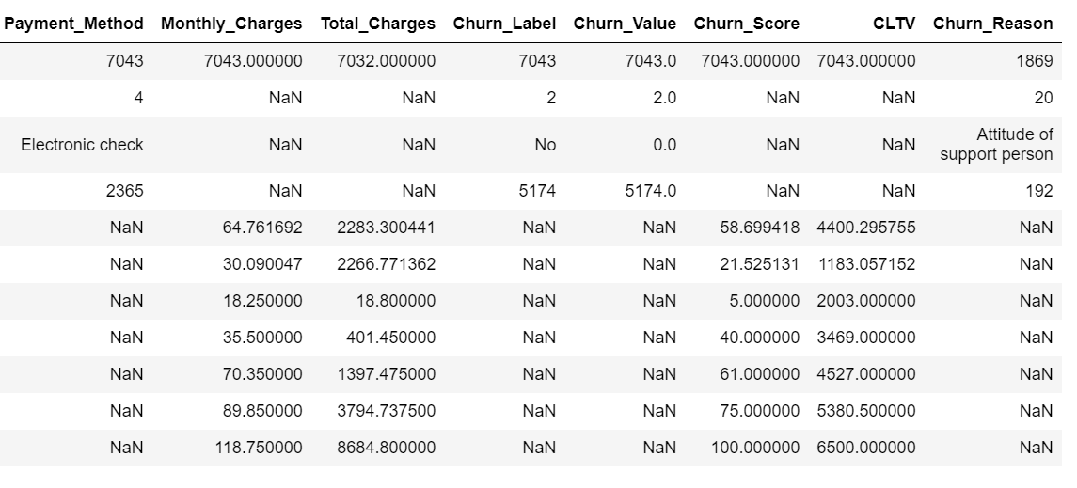
Summary of Table

Slide 8
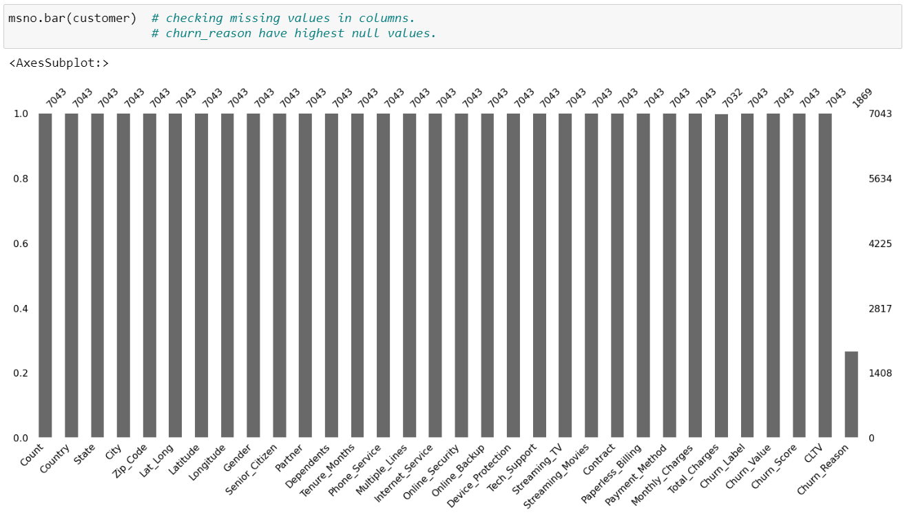
Checking Null Values

Slide 9
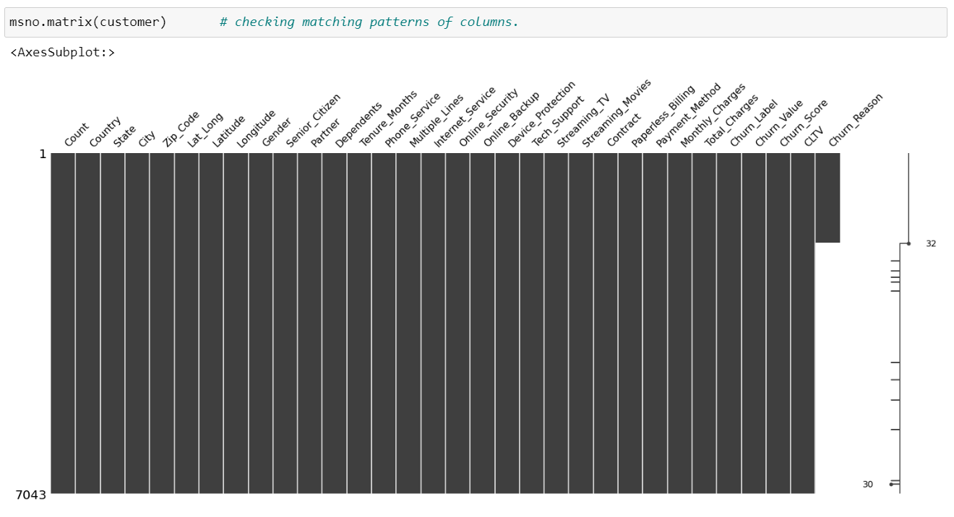
Checking patterns

Slide 10
apply appropriate statistical measures using python based on data types.

Slide 11
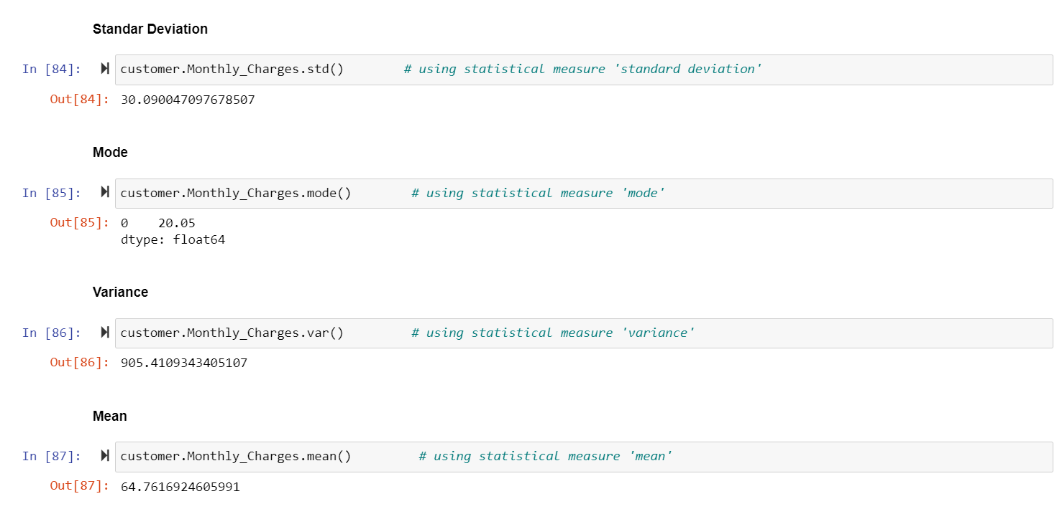

Slide 12
What is the percentage of females and senior citizens in this data set? Please create appropriate plots and explain the plots.

Slide 13
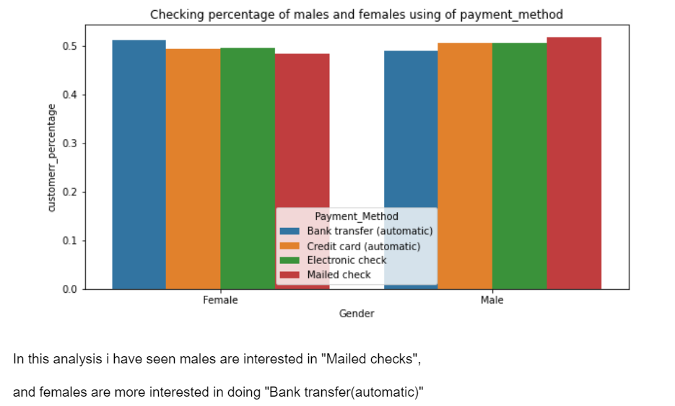
(a) Gender with the percentage

Slide 14
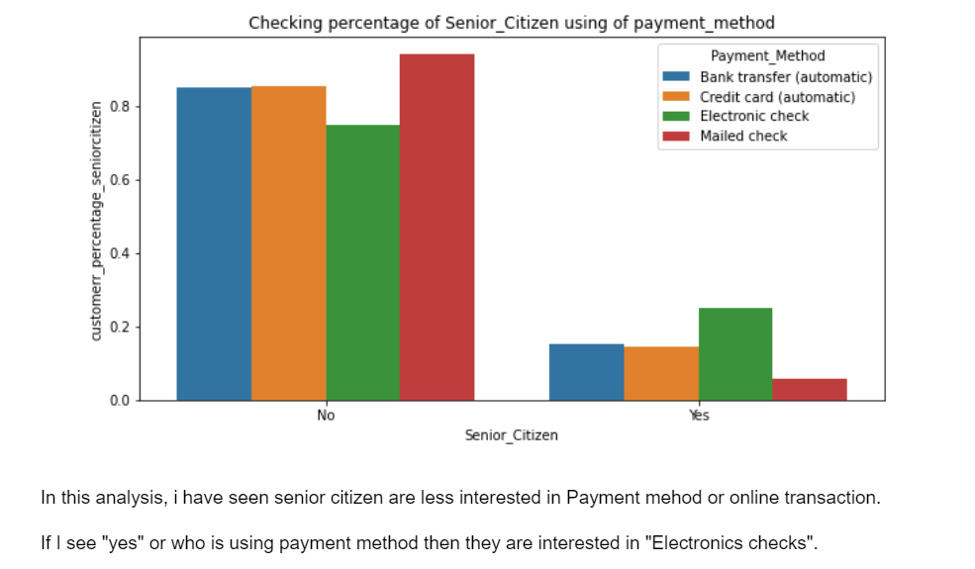
(b) Senior citizen with Percentage

Slide 15
create an appropriate plot to examine the distribution of the tenure month column and explain the distribution. Based on distribution, perform appropriate statistical measures. Please also explain if the variable is symmetric or skewed. Please calculate it. Explain everything as asked.

Slide 16
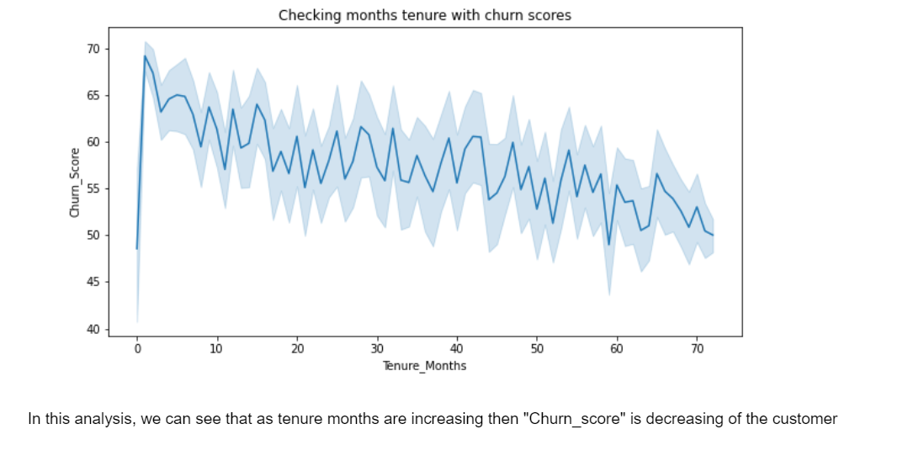
(a) Tenure_Month with Churn_score

Slide 17
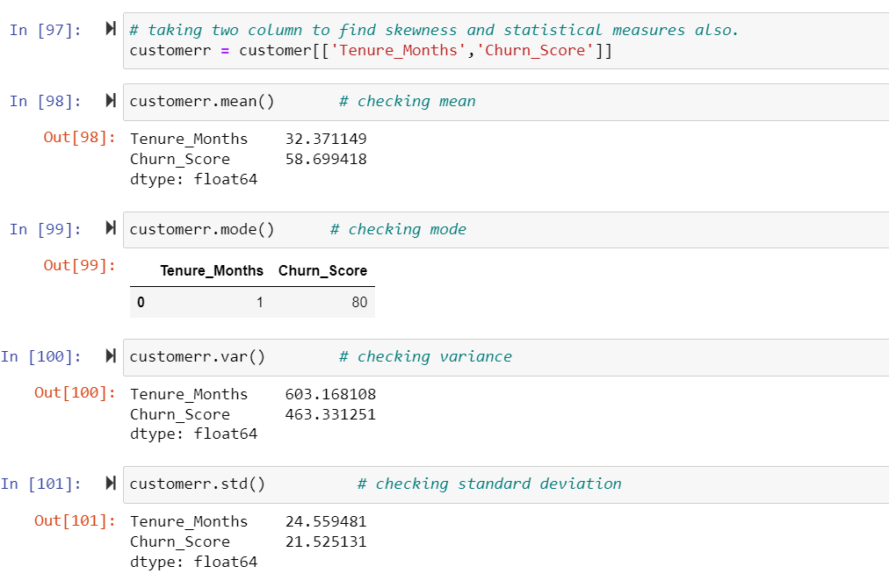
(b) Statistical Measures

Slide 18
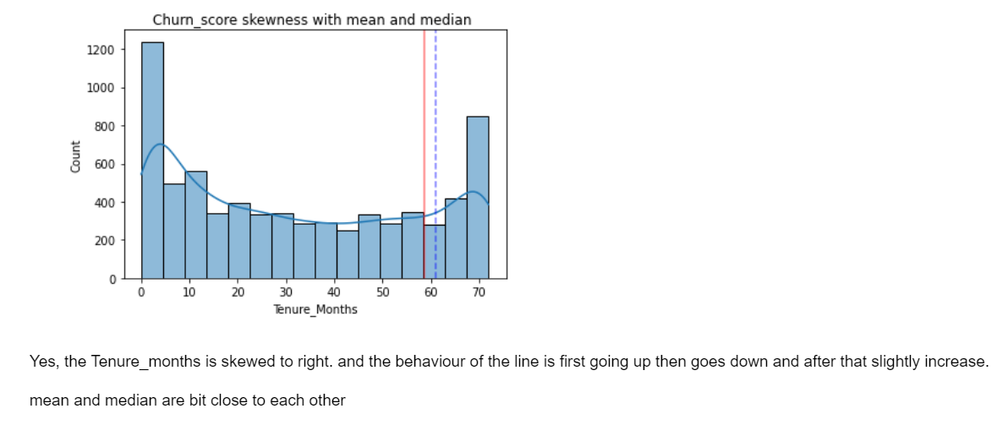
(c) Skewness

Slide 19
convert all binary columns into 0 and 1 using appropriate programming constructs, not one by one.

Slide 20
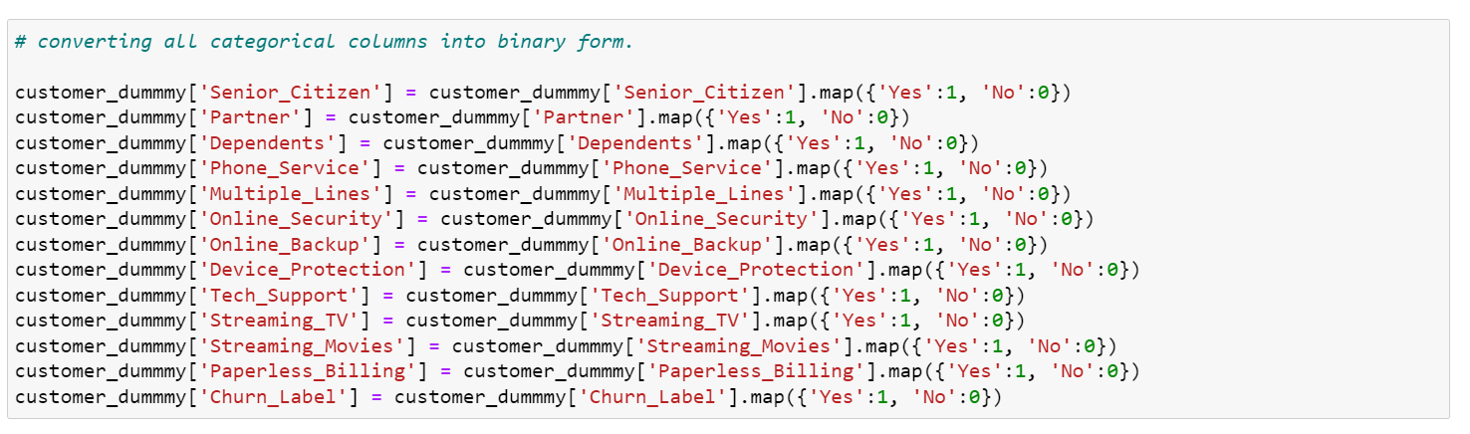
Binary columns

Slide 21
examine the distribution of monthly charges between males and females using box plots. Please explain the results also.

Slide 22
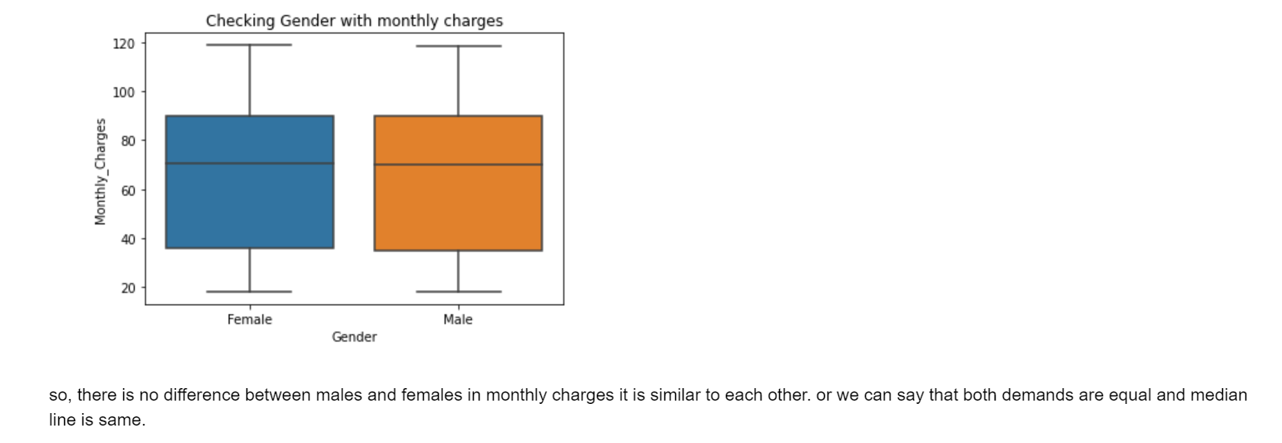
Monthly charges with Gender

Slide 23
find what is the minimum total charges for Los Angeles city. Please find which zip code has the maximum total charges.

Slide 24
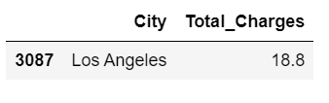
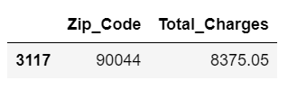
(a) Minimum total charges of Los Angeles City
(b) Zip code with highest Total charge

Slide 25
find which payment method has the highest churn score and which has the lowest churn score.

Slide 26
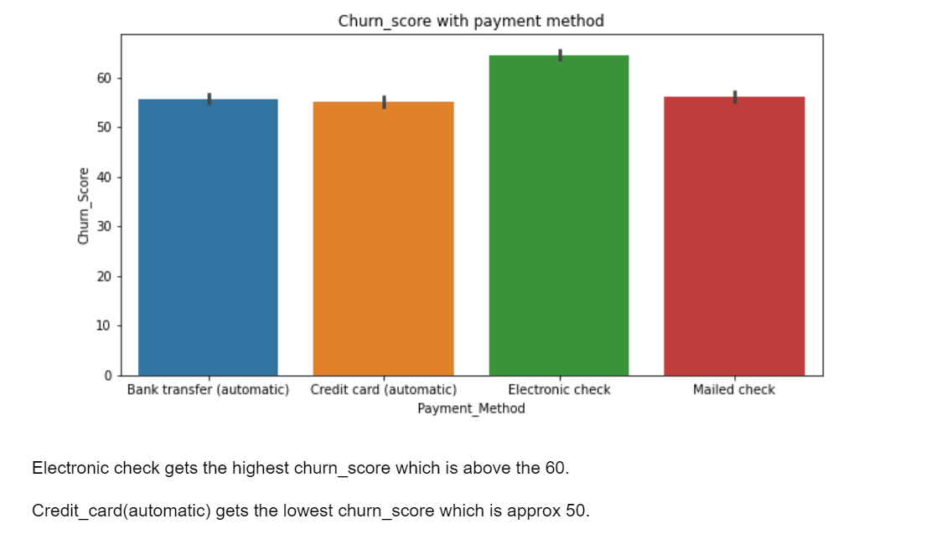

Slide 27
create an appropriate plot to check the count of payment methods and explain it.

Slide 28
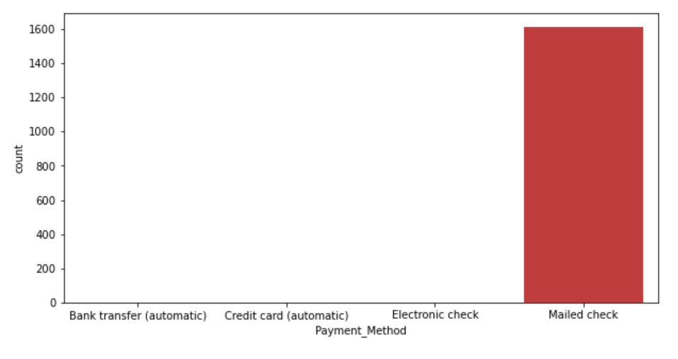
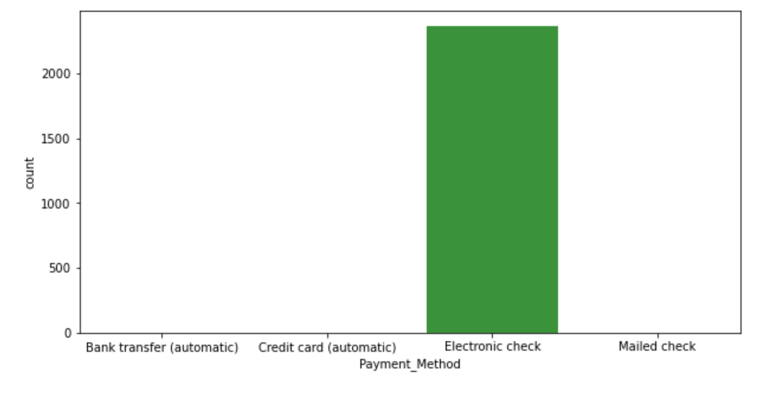
(a) Mailed Check
(b) Electronic Check

Slide 29
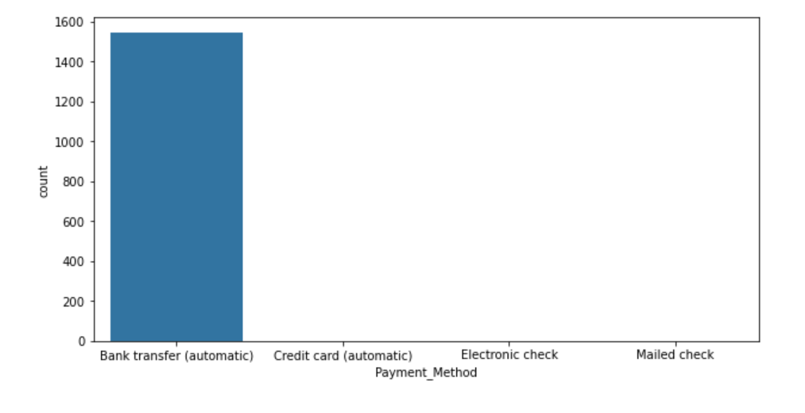
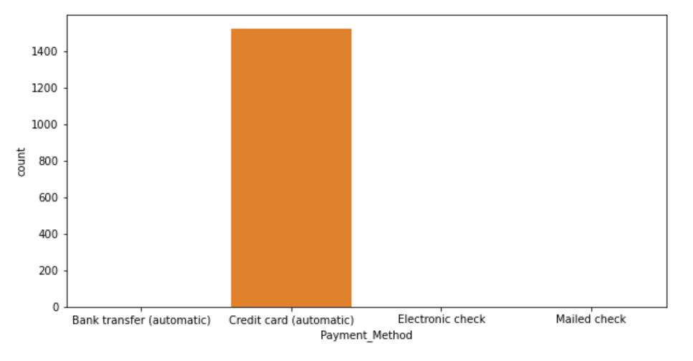
(c) Bank Transfer
(d) Credit Card

Slide 30
create an appropriate plot to see the relationship between monthly charges and total charges.

Slide 31
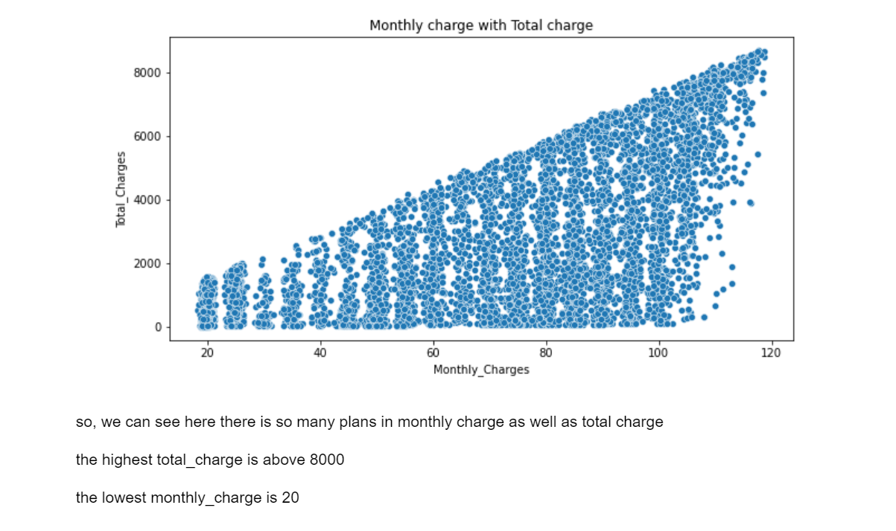
Analysis with Scatter plot

Slide 32
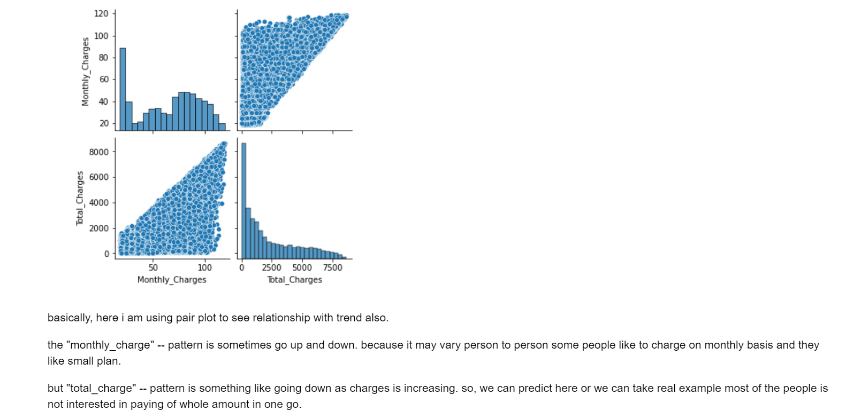
Analysis with Pair plot

